Slide 1
Secure Web Programming
Lecture 11 Different ways of dynamic web pages
Amanda.Lunt@utas.edu.au
Soonja.Yeom@utas.edu.au

Slide 2
Topics
Secure Web Programming
Week13
Review
Basic Web Programming
Web Security
Adv. Web Programming
Fundamentals – protocol, CS model, etc.
HTTP Protocols, Storage
Advanced Web Applications
Human Computer Interaction with Web Page Design
Security Issues and Technologies
Session management
Client-side Scripting Language and Document Object Model
Secure Programming and Users
Common Gateway Interface
Server-side Scripting Language and Privilege configuration
Encryption and Authentication
Advanced Security Issues

Slide 3
Review: Website Design
What to consider?
Content
Target audience
Organising (Navigation, Site structure)
Visual appearance
Usability

Slide 4
Review: Design Web Site/interface
Principles to remember
Consistency
Target audience
Readability
Plan and design your screen, functionality, navigation

Slide 5
Review: Assistive Technology
Screen readers (e.g JAWS for Windows, Voiceover for Mac)
Screen magnification software (e.g handheld magnifier over it)
Text reader (synthesized voice)
Speech input software (e.g Dragon Naturally Speaking)
Alternative input devices
Head pointers
Motion tracking or eye tracking
Single switch entry devices (e.g. on-screen keyboard with a cursor)

Slide 6



Dynamic Web Page
Dynamic Web Page Process
Application Server
Client Computer (Browser)
Web Server
Database

Slide 7
Dynamic Web Page Solution
Client-side scripting
the type of user interaction (i.e. mouse or keyboard action)
JavaScript, DHTML, ActionScript
Server-side scripting
CGI (Common Gateway Interface)
Advanced CGI
JSP, ASP, PHP

Slide 8
What is CGI?
CGI (Common Gateway Interface)
a standard way for a web server to pass client data to another process, and have the output from that process sent back to the client
ie., permit web clients to execute programs on a web server and receive their output
the external application is often referred to a "CGI" but this is technically incorrect
the CGI process is started by the web server
it is a child process of the web server

Slide 9

CGI LifeCycle
Client Computer (Browser)
Web Server
CGI
Web server send the request message to the CGI program in environment variables
the web server can send data to the child CGI process via the child's STDIN
the web server reads data that the child sends to its STDOUT, and passes this back to the web client
Database
CGI Program

Slide 10
Program Languages under CGI
The following languages commonly used for programs running under CGI:
Perl
C/C++
VBScript
Any Language that will run on the system
What makes the developers choose the language?
Performance (complied or interpreted), Tools or support (debuggers, complies, libraries, …), Code reusability, etc.

Slide 11
CGI with Compiled Language
Compiled Languages:
C, C++, FORTRAN, Pascal, etc.
advantages
compact, fast execution time in general
Short code
reduced impact on the server
disadvantages
usually difficult to manipulate strings
many CGIs do a lot of string manipulation
modifications require recompilation
slows development cycle

Slide 12
CGI with Compiled Language: C++ or C
C++ or C
Most popular language for most platforms
including Unix, Windows, Macintosh
Good performance for large size program
lower level programming
More difficult to write the program than Perl
Low level programming is possible (powerful but difficult to handle)
HTTP is based on text format and handling string data (using pointer or array) is difficult in C (or C++)

Slide 13
CGI with Interpreted Language
Interpreted Languages:
Perl, Unix shell scripts, Tcl
advantages
dependent on the language
eg., Perl has very powerful string handling
often easier to modify
don't need to recompile to retest
disadvantages
slower execution time
may not be extensible/functional

Slide 14
CGI with Interpreted Language: Perl
PERL
a freely available scripted programming language for most platforms
including Unix, Windows, Macintosh
borrows from many Unix programs
sh, csh, sed, awk, + others
object-oriented features
good text handling & reporting facilities
subroutines with parameter passing
simple database capability
extremely large archive of add-ons (CPAN)

Slide 15
Interpreted vs Compiled (CGI)
Speed:
Most interpreted languages are slower than compiled CGIs.
Some interpreted languages, such as PERL and AppleScript, are faster than Shell CGIs, but still slightly slower than compiled CGIs.
Security:
Improperly written scripts can cause various types of security issues.
Script programs must be carefully written so as to prevent a user from causing crashes, obtaining secure information, gaining access to a prompt, etc.

Slide 16
Interpreted languages
Easy development:
The benefit of using interpreted languages, such as shell or PERL, is that it is very easy to write and develop.

Slide 17
Implementation
when you write a CGI, it must
be executable (Unix 0755)
have the appropriate extension (.cgi)
be located in an appropriate directory
often CGIs are installed in a standard directory on the web server (/cgi-bin)
server may be configured to allow CGIs in any directory
alacritas does not allow CGIs (currently..)
TRY THIS IN YOUR PC or MAC ☺
your CGIs run with your UID, and hence have your permissions on the entire system
security implications

Slide 18
How forms are processed in CGI
the web server sees that the URL is for a CGI, and spawns the CGI child process
the CGI
receives and processes the data from the form according to the method in the request message
generates content (normally HTML file) for the client and output to the web server

Slide 19
How CGI receives input
Input for CGI is the parameter or information from the client
may be from the URL
may be data from a form
Two methods that may be used to send this information to the CGI
GET is used for simple data, or just a few fields on a form
POST is used for complex forms or data
actual method is indicated in the first line of the HTTP request
Browser generate the method in the HTTP request according to ‘method’ attribute of <form> tag

Slide 20
CGI Example with PERL
The example will demonstrate how forms are processed CGI
With PERL (Interpreted Language)
GET Method

Slide 21
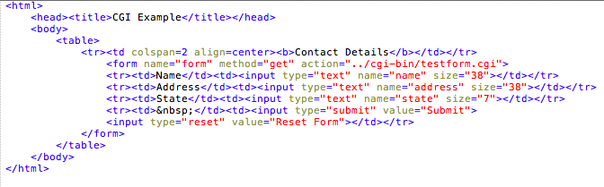
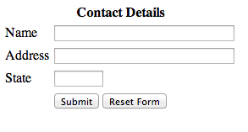
HTML FORM (GET METHOD)

Slide 22
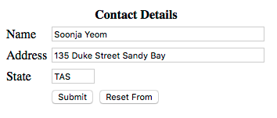
What CGI Receives
After clicking the submit button
Parameters from forms as string
name=Soonja+Yeom&address=135+Duke+Street+Sandy+bay&state=TAS

Slide 23
Decoding CGI-GET Input

Slide 24
End Result
if earlier form was decoded with previous script, $contents hash would look like this:
$contents{"name"} = "Soonja Yeom";
$contents{"address"} = "135 Duke Street Sandy Bay";
$contents{"state"} = "TAS";
with the data decoded, we can now process the form further

Slide 25
CGI output to Server (HTML format)

Slide 26
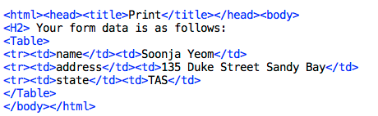
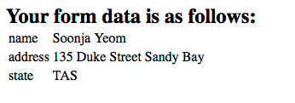
Output of CGI

Slide 27
More CGI with PERL example
Please have a look at more examples:
http://www.tutorialspoint.com/perl/perl_cgi.htm
Simple FORM example: GET method
Passing information using: POST method
Passing data to CGI Program
Checkbox data
Radio Button data
Textarea data
Dropdown box data
Cookie in CGI

Slide 28
FastCGI
Fast CGI
Exactly same as CGI but few extensions
Fast, Open and Secure Web server interface
Solves the Performance problems in CGI
No overhead and complexity of proprietary APIs
Provides the Development Kit - C, C++, Perl, and Java, libraries as well as assorted documentation
http://www.fastcgi.com/

Slide 29
Benefits of using Fast CGI
Distributed computing:
Run FastCGI application on a different machine from the one on which they run their Web server.
The technique for scaling, linking to existing corporate systems, improving system availability, and improving security via compartmentalization, such as firewalls.
Multiple and extensible roles:
computing the response to an HTTP request
Performing modular authentication and authorization checks and translate data from one type to another

Slide 30
CGI::SpeedyCGI
SpeedyCGI is a way to run PERL scripts persistently
Also called as ‘PersistentPerl’
Run much more quickly (Speed)
After the initial run, the PERL interpreter is kept running.
Provides an Apache module so that under the Apache web server
scripts can be run without the overhead of doing a fork/exec for each request

Slide 31
Interpreted Markup Languages
Statements embedded into the HTML are interpreted by the server (or interpreting engine attached to server) before being returned to the client
Interpreted Markup Languages with database connectivity:
JSP (JavaServer Pages)
ASP (ActiveServer Pages)
PHP (PHP Hypertext Preprocessor)
Others: Cold Fusion, Zope, etc.

Slide 32
JSP (JavaServer Page)
A technology for developing web pages that support dynamic content.
Insert java code in HTML pages by making use of special JSP tags.
Start with <% and end with %>.
Performance is significantly better because JSP allows embedding Dynamic Elements in HTML Pages itself instead of having a separate CGI files.
JSP are always compiled before it's processed by the server unlike CGI/Perl which requires the server to load an interpreter and the target script each time the page is requested.

Slide 33
Difference between JSP and JavaServlet
JSP
Do not need to compile
Put Java inside HTML code
Easy to learn (Easy to separate controller/view/model part)
JavaServlet
Be required to compile and upload webserver/servlet engine
Put HTML inside Java code
Does not manage any ‘presentation/ view’ part.
Almost all about the ‘controller’ part
Business logic or calculation

Slide 34
JSP – Servlet Lifecycle
Database
Web Server with Servlet
Client Computer (Browser)
Java Beans
Processed JSP
Client-side
Server-side

Slide 35
PHP
an HTML-embedded server-side scripting language commonly used on web servers
used to make web pages dynamic
PHP is an interpreted language
generates HTML and/or other resources and send them to client browsers
Easy to use
language itself simple and easy to learn
lots of built-in functionality
can be use a number of different editors
similar syntax to C / C++ / Java / JavaScript …
Open source, Multiple platform

Slide 36

PHP LifeCycle
Web Server
Client Computer (Browser)
Database
PHP Interpreter
Client-side
Server-side

Slide 37
PHP, JSP, and ASP
 | PHP | JSP | ASP
Operating System (OS) | Linux (Unix) Windows | Linux (Unix) Windows | Windows
Web Service Demon | Apache, IIS (Internet Information Server) | Apache*, IIS | IIS, PWS (Personal Web Server)
Script Interpreter | PHP | Tomcat, Resin, Jrun, Weblogic, GNU JSP, WebSphere, OSDK, JServ | IIS PWS (Personal Web Server)
Database | Oracle, MySQL, MS SQL, Access, etc. | Oracle, MySQL, MSSQL, Access, etc. | MS SQL, Oracle, Access, etc.

Slide 38
Dynamic Web Page Solution
Dynamic Web Page Process
Application Server
?
Client Computer (Browser)
Web Server
Database

Slide 39
In Summary
Dynamic Web page Solution: Server-side
CGI (Common Gateway Interface)
Advanced CGI
JSP, ASP, PHP

Slide 40
Thank you
Any Questions

